Slide 1
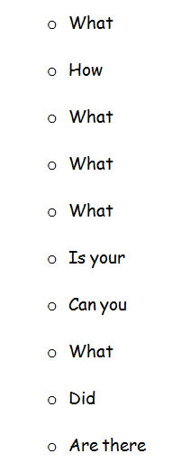
Questions?
is it?
do you do it?
is the problem that you might like to solve?
already exist?
materials can you use?
prototype doing what you want to do?
improve it?
changes would you like to make?
it fail completly?
any problems or challenges you would like to solve?

